Slide 1
Jenkins Continuous Build System
Michal Jurčo
Notes:
ID=d924773e-9a16-4d6d-9803-8cb819e99682 Recipe=text_billboard Type=TextOnly Variant=0 FamilyID=AccentBoxWalbaum_Zero

Slide 2
Summary
Continuous integration systems are a vital part of any Agile team because they help enforce the ideals of Agile development
Jenkins, a continuous build tool, enables teams to focus on their work by automating the build, artifact management, and deployment processes
Jenkins’ core functionality and flexibility allow it to fit in a variety of environments and can help streamline the development process for all stakeholders involved

Slide 3
Agenda
Continuous Integration (CI)
What is it?
What are the benefits?
Continuous Build Systems
Jenkins
What is it?
Where does it fit in?
Why should I use it?
What can it do?
How does it work?
Where is it used?
How can I get started?

Slide 4
Continuous Integration (CI)

Slide 5
What is it?
practice of merging all developers working copies to shared mainline several times a day
the more developers work on a particular project, the higher is probability of integration hell
integration hell - when work around the integration of the original code takes more time than the production of the code itself

Slide 6
What does it mean?
At a regular frequency (ideally at every commit), the system is:
Integrated
All changes up until that point are combined into the project
Built
The code is compiled into an executable or package
Tested
Automated test suites are run
Archived
Versioned and stored so it can be distributed as is, if desired
Deployed
Loaded onto a system where the developers can interact with it

Slide 7
CI tools
Code Repositories
Continuous Build Systems
Test Frameworks
Artifact Repositories

Slide 8

Jenkins

Slide 9
Jenkins
Self-contained, open source automation server
For building, testing, delivering and deploying software
Java based – WAR
Native system packages, Docker, or run standalone

Slide 10
Why Jenkins?
Highly configurable, flexible
Wide range of community developed plugins
Free, open source, released under MIT license
It’s easy to write plugins

Slide 11
What can Jenkins do?
Generate test reports
Integrate with different Version Control Systems
Push to various artifact repositories
Deploys directly to production or test environments
Notify stakeholders of build status
…and much more – plugins!

Slide 12
Pipelines
A continuous delivery pipeline is an automated expression of the process for getting software from version control to users and customers
Jenkins Pipeline is written into a text file (Jenkinsfile) and checked into SCM
Written in Groovy, domain-specific language

Slide 13
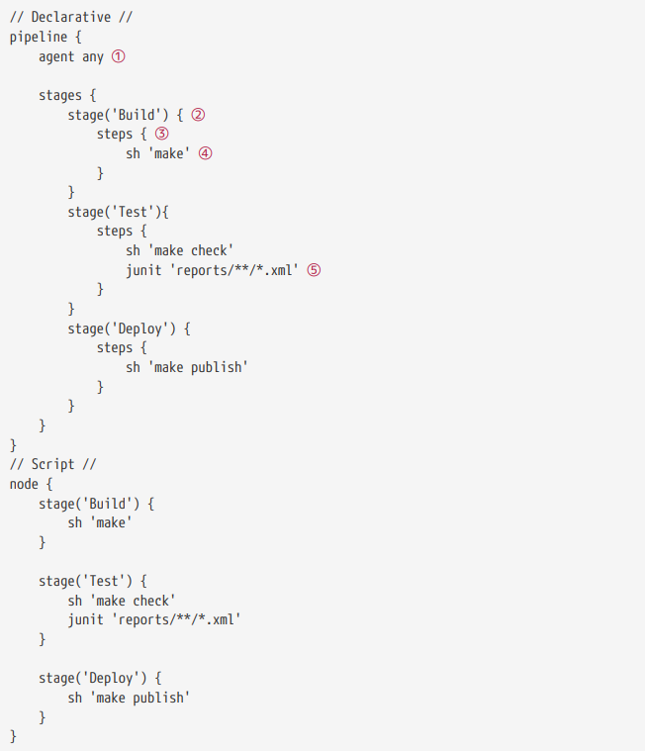
Pipeline example

Slide 14
Demo
https://github.com/yolloz/jenkins-pipeline-with-docker

Slide 15
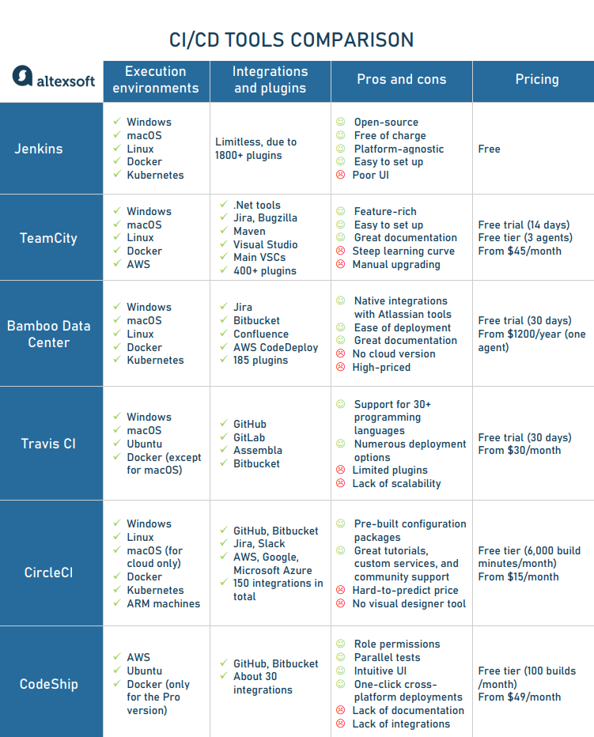
Comparison of CI/CD tools
Link to picture

